Slide 1
ATOMIC ENERGY EDUCATION SOCIETY Distant Learning Programme Class XI Subject: Physics Chapter: Unit and Measurement (Module 3/4)
Contents :
Propagation and combination of errors in addition, substraction,multiplication,division & power raised to quantity.
Significant figures and their rules.
Rounding off of uncertain digit in significant figure.
Rules for Arithmetic Operations with Significant Figures.

Slide 2
Propagation and Combination of Errors
a) Combination of Error of a sum : Suppose two physical quantities A and B have measured values A ± ΔA, B ± ΔB respectively where ΔA and ΔB are their absolute errors. We wish to find the error ΔZ in the sum
Z = A + B.
We have by addition, Z ± ΔZ =(A ± ΔA)+(B ± ΔB )
The maximum possible error in Z is ± ΔZ = ±(ΔA + ΔB)
Hence the rule : When two quantities are added,the absolute error in the final result is the sum of the absolute errors in the individual quantities.

Slide 3
b) Combination of Error of difference
Suppose two physical quantities A and B have measured values A ± ΔA, B ± ΔB respectively where ΔA and ΔB are their absolute errors. We wish to find the error ΔZ in the difference
Z = A - B.
We have by subtraction, Z ± ΔZ =(A ± ΔA)-(B ± ΔB )
Z ± ΔZ = (A – B) ± ΔA ± ΔB
The maximum possible error in Z is ±ΔZ = ±(ΔA + ΔB)
Hence the rule : When two quantities are subtracted, the absolute error in the final result is the sum of the absolute errors in the individual quantities.

Slide 4
(c) Combination of Error of a product
Suppose Z = AB and the measured values of A and B are A ± ΔA and B ± ΔB. Then
Z ± ΔZ = (A ± ΔA) (B ± ΔB)
= AB ± B ΔA ± A ΔB ± ΔA ΔB.
Dividing LHS by Z and RHS by AB we have,
1±(ΔZ/Z) = 1 ± (ΔA/A) ± (ΔB/B) ± (ΔA/A)(ΔB/B).
Since ΔA and ΔB are small, we shall ignore their product. Hence the maximum relative error
± ΔZ/ Z = (ΔA/A) + (ΔB/B).
Hence the rule : When two quantities are multiplied or divided, the relative error in the result is the sum of the relative errors in the multipliers.

Slide 5
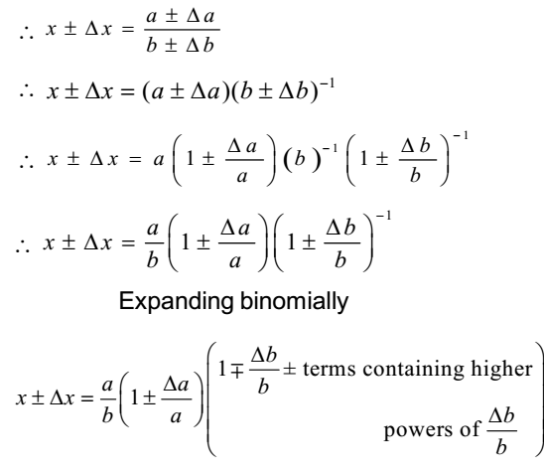
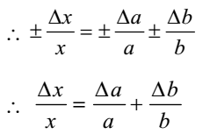
(d) Combinition of Error of a quotient

Slide 6
(e)Error in case of a measured quantity raised to a power
Suppose Z = A²,
Then, ΔZ/Z = (ΔA/A) + (ΔA/A) = 2 (ΔA/A).
Hence, the relative error in A² is two times the error in A.
In general, if Z = A^{p} B^{q}/C^{r}
Then,
± ΔZ/Z = p (ΔA/A) + q (ΔB/B) + r (ΔC/C).
Hence the rule : The relative error in a physical quantity raised to the power k is the k times the relative error in the individual quantity.

Slide 7
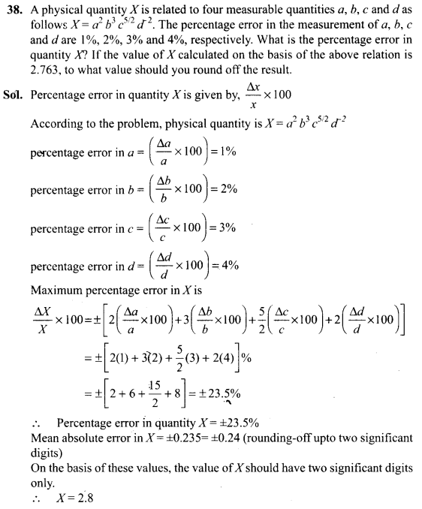

Slide 8
Significant figures
In any measured quantity the reliable digits plus the first uncertain digit are known as significant digits or significant figures.
For Ex. If we say the period of oscillation of a simple pendulum is 1.62 s, the digits 1 and 6 are reliable and certain, while the digit 2 is uncertain.
More no. of significant figure means more precise that measured quantity.

Slide 9
Rules for determining significant figures

Slide 10
Rules for rounding off uncertain digit
Insignificant digit to be dropped is more than 5 Preceding digit is raised by 1.
Ex. Number : 3.137 Result : 3.14
Insignificant digit to be dropped is less than 5 Preceding digit is left unchanged
Ex. Number : 3.132 Result : 3.13
Insignificant digit to be dropped is equal to 5 If preceding digit is even, it is left unchanged.
Ex. Number : 3.125 Result : 3.12
Insignificant digit to be dropped is equal to 5 If preceding digit is odd, it is raised by 1.
Ex. Number : 3.135 Result : 3.14

Slide 11
Rules for Arithmetic Operations with Significant Figures
In multiplication or division, the final result should retain as many significant figures as are there in the original number with the least significant figures.
In the example given, density should be reported to three significant figures.
Density =(4.237g/2.51 cm) = 1.69 gcm³
In addition or subtraction, the final result should retain as many decimal places as are there in the number with the least decimal places.
For example, the sum of the numbers 436.32 g, 227.2 g and 0.301 g by mere arithmetic addition, is 663.821 g. But the least precise measurement (227.2 g) is correct to only one decimal place. The final result should, therefore, be rounded off to 663.8 g.

Slide 12
References : NCERT XI class Wikipedia Concept of physics by H C Verma
By: Govind Sharma
PGT (Physics)
AECS 4, Rawatbhata

